Slide 1
Eye Tracking Goggles
Group 29
Patrick Gonzalez CpE Michael Fillinger CpE James Curtis EE Timothy Wells EE
Notes:
Introduce Ourselves

Slide 2
Motivation
The ability to control machines through eye tracking
Be able to use it inside things like helmets or goggles
Through less complex means than camera, like IR
Cheaper alternative to eye tracking as opposed to using a camera
Notes:
Patrick

Slide 3
Goals and Objectives
Create
Create an array of IR emitters and sensors around each eye
Convert
Convert the analog data to a digital signal
Develop
Develop an algorithm for the microcomputer to determine the eyes position
Use
Utilize the algorithm to incorporate eye tracking into an application
Notes:
Patrick

Slide 4
Specifications
Component | Parameter | Specification
Goggles | Weight | < 4 pounds
Processing Unit & Application | Response Time | < 200 milliseconds
A/D Converter | Resolution | >= 8 bits
Goggles | Size | 56 cm – 65 cm (Circ.)
Application | Eye Positioning | >=5 Eye Positions
Sensor | Voltage | Changing from Low Voltage to High Voltage
System Power Consumption | Watts | <50 Watts
Notes:
Patrick Create 7 to 9 Specifications with 3 of them being Demo-able

Slide 5
Block Diagram
Notes:
Patrick Explain Coloration. Make Font Larger, Place Names on Colors

Slide 7
Project Design Approach
Use IR emitters to shine light on the eye
Use IR detectors to retrieve the reflected light
Use the MCU to process the signal from the detectors, convert it to a value and transmit to the microcomputer
The microcomputer will then analyze the data and apply it accordingly
Notes:
Tim

Slide 8
System
Notes:
Make Font Larger

Slide 9
Reasoning
IR Array | Camera | Surface Conductivity Monitors
+/- Simpler Data Flow | - More Computation Intensive
+ Half of the data is not processed by the main processor | - High Data Usage | + Half of the data is processed outside the main processor
+ Mostly a closed system | - More sensitive to environmental lighting | - Sensitive to changes to the users body
- Less Accurate Tracking | + Higher Accuracy | - Unknown How Accurate
Notes:
Timothy Use a Table for IR Array vs Camera

Slide 10
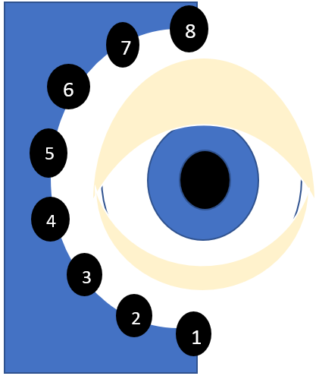
Concept of our system
IR array
Array | right | left
Sensor 1 | medium | …...
Sensor 2 | medium | …...
Sensor 3 | low | …...
Sensor 4 | low | …...
Sensor 5 | medium | …...
Sensor 6 | medium | …..
Sensor 7 | high | …..
Sensor 8 | high | …..
Notes:
timothy

Slide 11
Concept of our system
IR array
MCU
Data from array
Analog to Digital Conversion
Sensor Data
Microcomputer
Application
Eye State
Algorithm
Serial Communication Protocol
Notes:
timothy

Slide 12
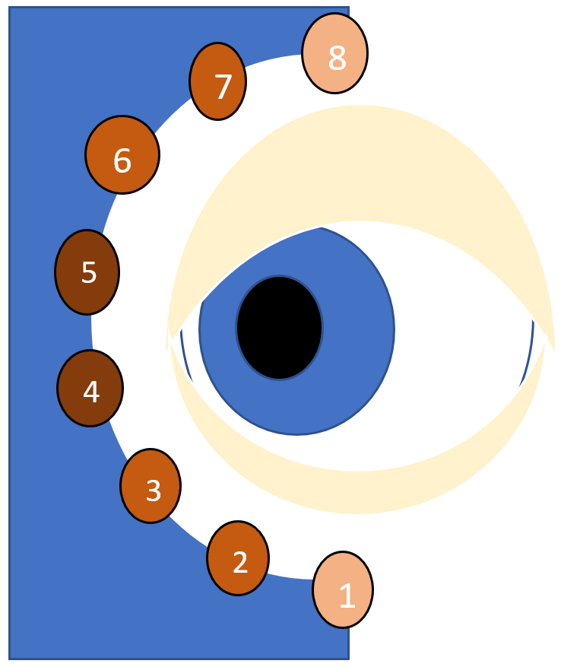
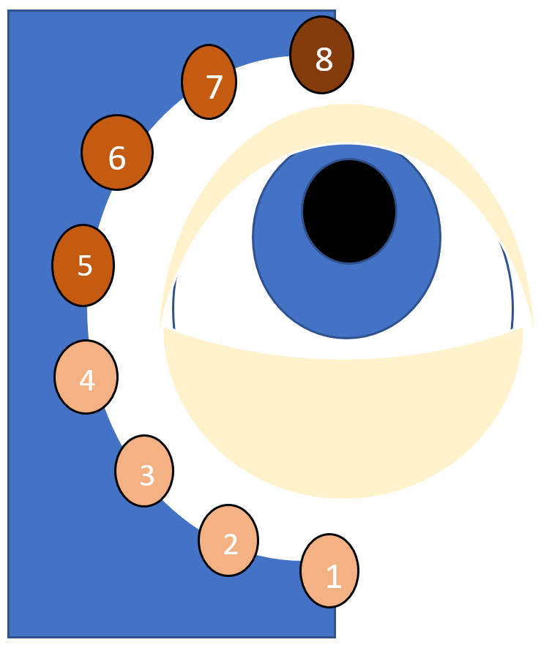
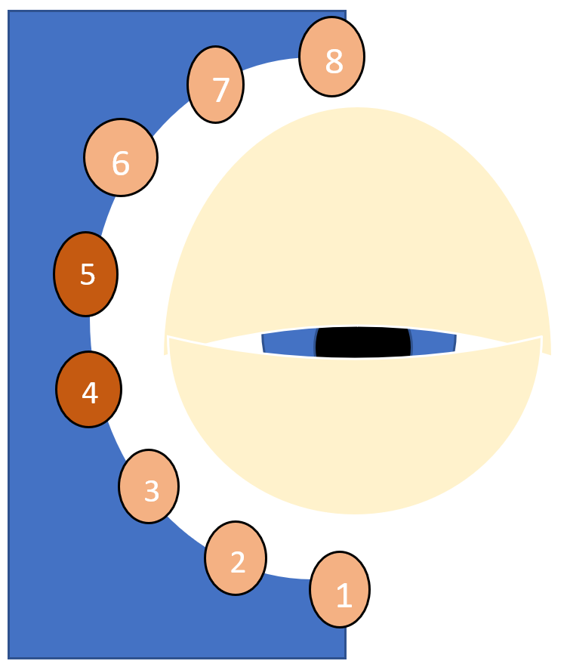
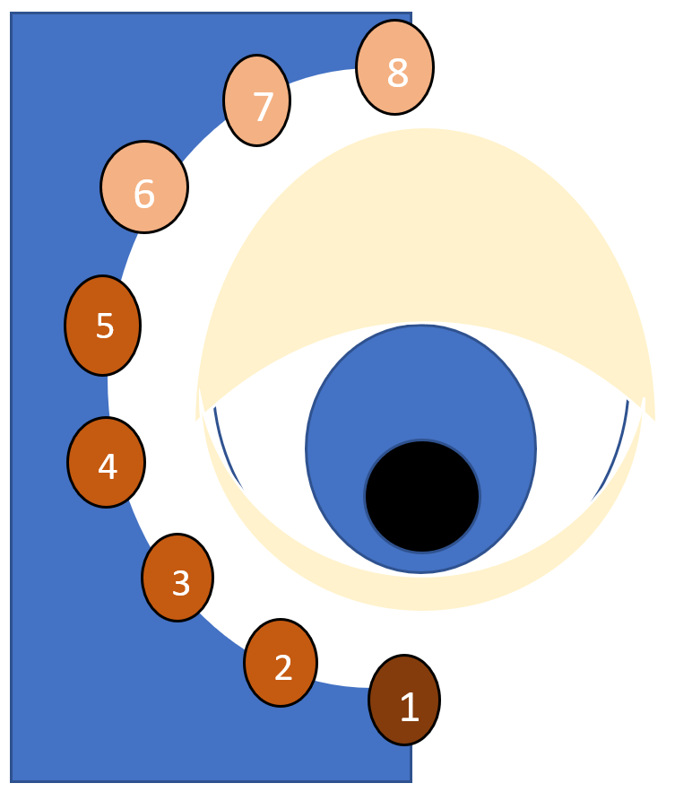
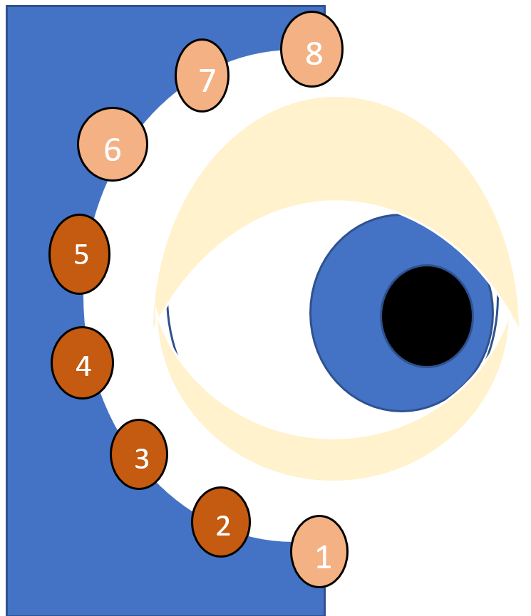
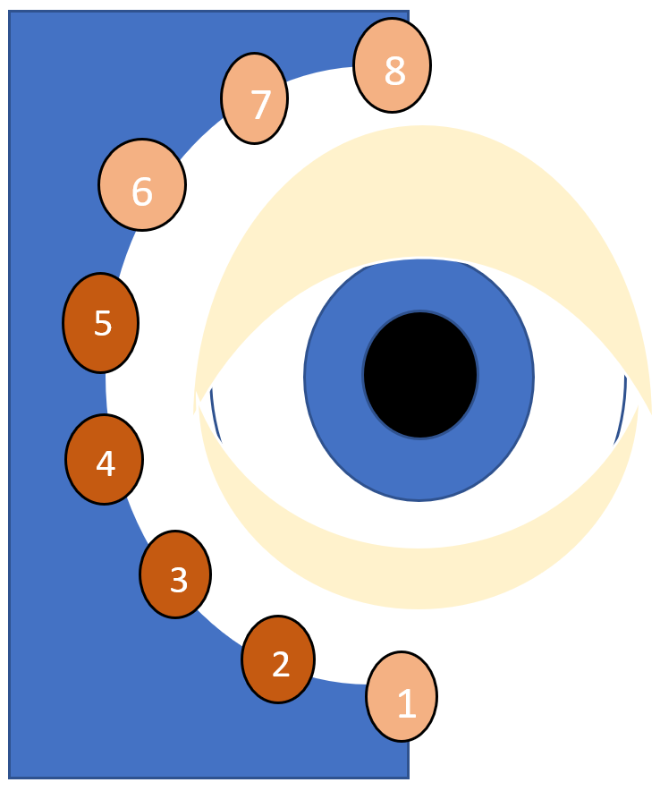
Examples
left
up
closed
down
right
straight
Notes:
timothy

Slide 13
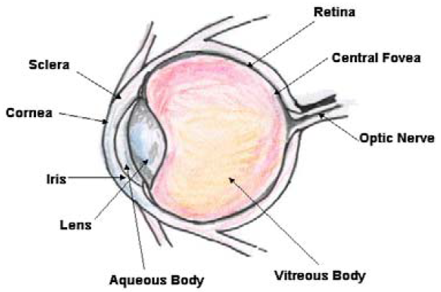
Health and Safety Standards for Eye Exposure to Infrared Light
IEC-62471 Standard Photobiological Safety of Lamps and Lamp Sources
Corneal Hazard Exposure Limits
Retinal Hazard Exposure Limits
Notes:
Patrick

Slide 14
Calculations of Hazardous Eye Exposure to Infrared Radiation
 | Time Exposed | Infrared Emitter Distance from Eye | Potency of Infrared Emitters | Exposure Limit | Calculated Exposure | Safety Factor Ratio $$(\frac{Exposure Limit}{Calculated Exposure})$$
Corneal Eye Exposure Data | 300 seconds (5 minutes) | 5 mm | 2.165 mW/Sr | 148.48 W/m | 108.25 W/m | 1.37
Retinal Eye Exposure Data | 300 seconds (5 minutes) | 5 mm | 2.165 mW/Sr | 918416.14 W/m /Sr | 325.85 W/m /Sr | 2818.52
2
2
2
2
Notes:
Include Equations over on this slide and write the title as calculations instead of measurements

Slide 15
PCB
Notes:
Mike

Slide 16
Converter board
Notes:
Mike

Slide 17
Power Systems

Slide 18
Primary Board Logic

Slide 19
I/O Ports
Sensor Inputs
Power I/O
JTAG
Programming
Interface
Additional GPIO

Slide 20
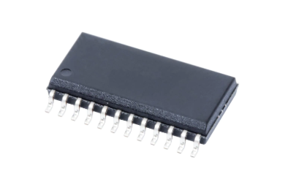
Reasoning for and comparisons of the Selector Chip
There are 16 individual sensors and each output analog signal
The converter can only do one source at a time
None of the sensors can share lines directly
Chip | Configuration | Resistance | Delay | Cost per unit | Place ordered
CD4067B | 16 to 1 | 125 Ω | 220ns | $1.34 | digikey.com
CD74HC4067M | 16 to 1 | 160 Ω | 51ns to 49ns | $0.93 | digikey.com
CD74HC4067M96 | 16 to 1 | 160 Ω | 51ns to 49ns | $0.80 | digikey.com
MPC506AU/1K | 16 to 1 | 1.5k Ω | 200ns to 250ns | $14.49 | digikey.com
CD74HCT4067M | 16 to1 | 180 Ω | 60ns to 55ns | $0.93 | digikey.com
Notes:
Mike Size of Selector Chip and Manufacturer

Slide 21
Analog to Digital Converter Chip Comparisons
Converter | Resolution | Cost | Shop
AD7829BRZ | 8-bit | $11.99 | mouser.com
MSP430FR6989 | 12-bit | $8.30 | Digikey.com
TLC0820AIDW | 8-bit | $5.98 | mouser.com
MCP3008 | 10-bit | $3.75 | adafruit.com
ADS10151DGSR | 12-bit | $2.76 | Digikey.com
Needs to convert voltage values
The ability to control the timing and pathing for the data
The speed needed to make it function in time with the user input
Notes:
Mike

Slide 22
Progress of the PCB
Successes
Difficulties
Design completed
Device was ordered and soldered
The complexities of the process to order the PCB
Devices on the PCB require different voltages for operation
Complications ordering parts due to COVID-19 pandemic
Notes:
Mike

Slide 23
Power
Notes:
Jimmy Make Font Larger

Slide 24
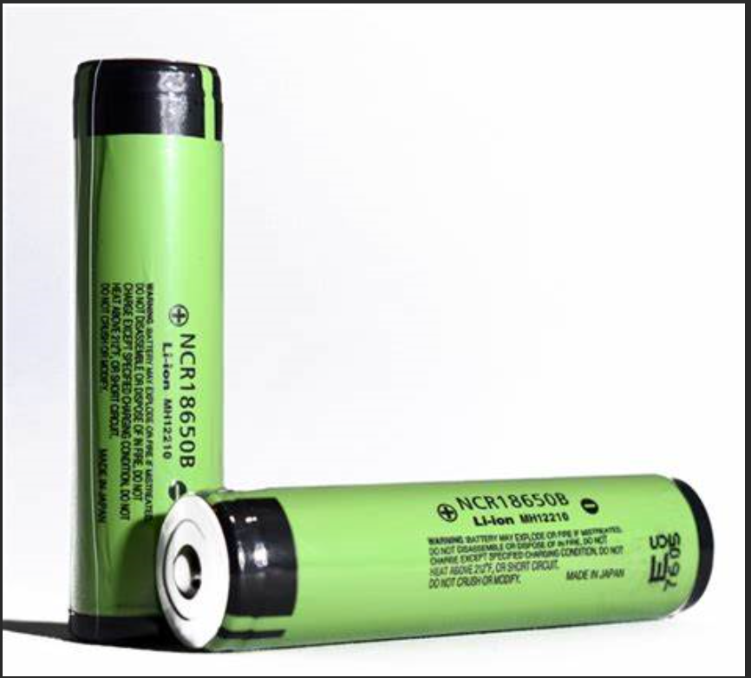
Power system
Runs off 2x ( LG HG2 18650 ) batteries
Output 5v to the converter board and 5v wire tap
Power the pi and display through wire tap to micro USB
Notes:
Jimmy

Slide 25
Power Consumption
Device | Power Consumption (Theoretical Max)
Microcontroller | ~4mA (100uA/MHz)
Raspberry Pi | 400mA
LCD Display Panel | 800mA
Sensor Array | 520mA
TOTAL | 1724mA
The LG HG2 18650 batteries are rated for 3000mAh
Using 2 in parallel should allow for more than 3 hours of operational time
Notes:
Jimmy

Slide 26
Progress of the Power
Successes
Difficulties
Found Batteries to power our device
Found converter chip to power raspberry pi nd LCD Display
Designed PCB
Changed design from using lithium battery packs
Needed to find converter chip or make new seperate PCB
Notes:
Jimmy

Slide 27
Processing Unit
Notes:
Make Font Larger

Slide 28
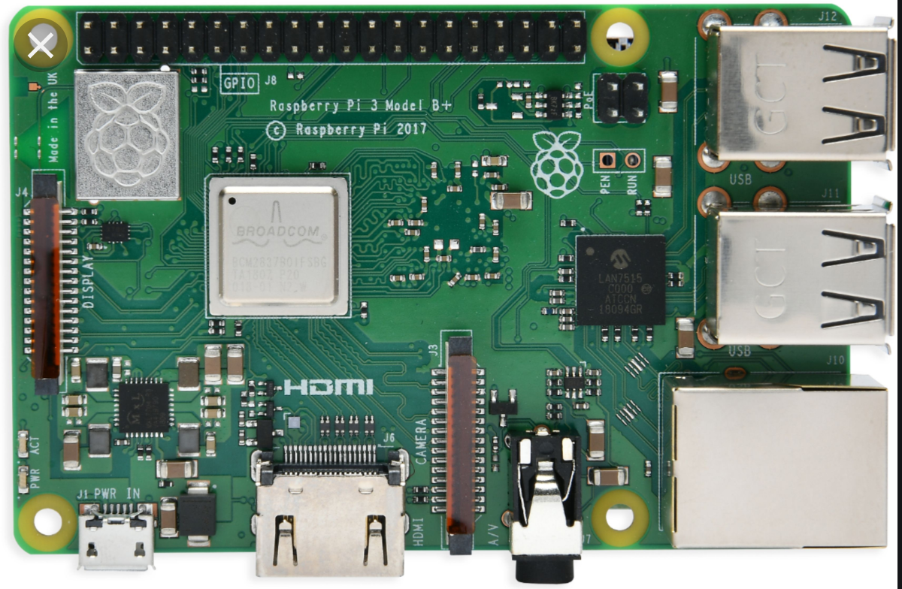
Main Processor Unit
Needs multi-core
Video capability
Name | Price (USD) | CPU clock speed | Size (in)
Rock64 | 44.95 (pine64.org) | 1.5GHz | 2.2x3.4
VIM2 v1.4 Basic | 79.99 (khadas.com) | 1.5GHz | 2.3x3.2
Raspberry Pi 3 model B | 47.69 (amazon) | 1.5GHz | 2.2x3.3
ASUS Tinker Board S | 89.40 (amazon) | 1.8GHGz | 4.5x6
ODROID-XU4 | 49.00 (hardkernel.com) | 2GHz | 2.3x3.3
Notes:
Patrick

Slide 29
Progress of the Processing Unit
Successes
Difficulties
Raspberry Pi has been acquired and loaded with a Linux OS
Pi is able to interface with the goggles display
Application and Algorithm fully functional on the Pi
Achieving Communication between the Raspberry Pi and the MCU was difficult

Slide 30
Goggles

Slide 31
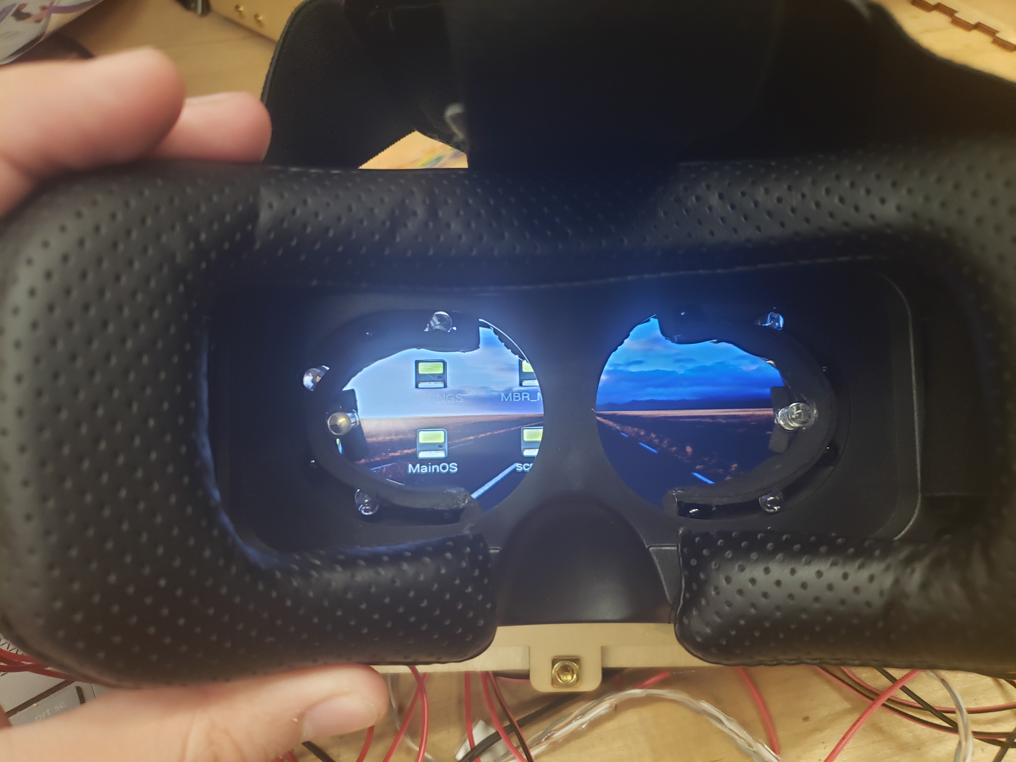
Comparison of Goggles
Product | Structure | Straps | Plus or Negative | Cost | Shop
UTOPIA360 | Solid plastic | T shape | Adjustable focus Leather seal | $36.82 | Walmart
Google Cardboard | Cardboard | Single | Not durable and cheaply made | $18.79 | Walmart
Self built | EVA foam | Any | Takes time to make | Un-known | Any-where
Google Daydream View | Hard plastic | Single | Can’t be modified easily | $79.99 | Walmart
Notes:
Jimmy

Slide 32
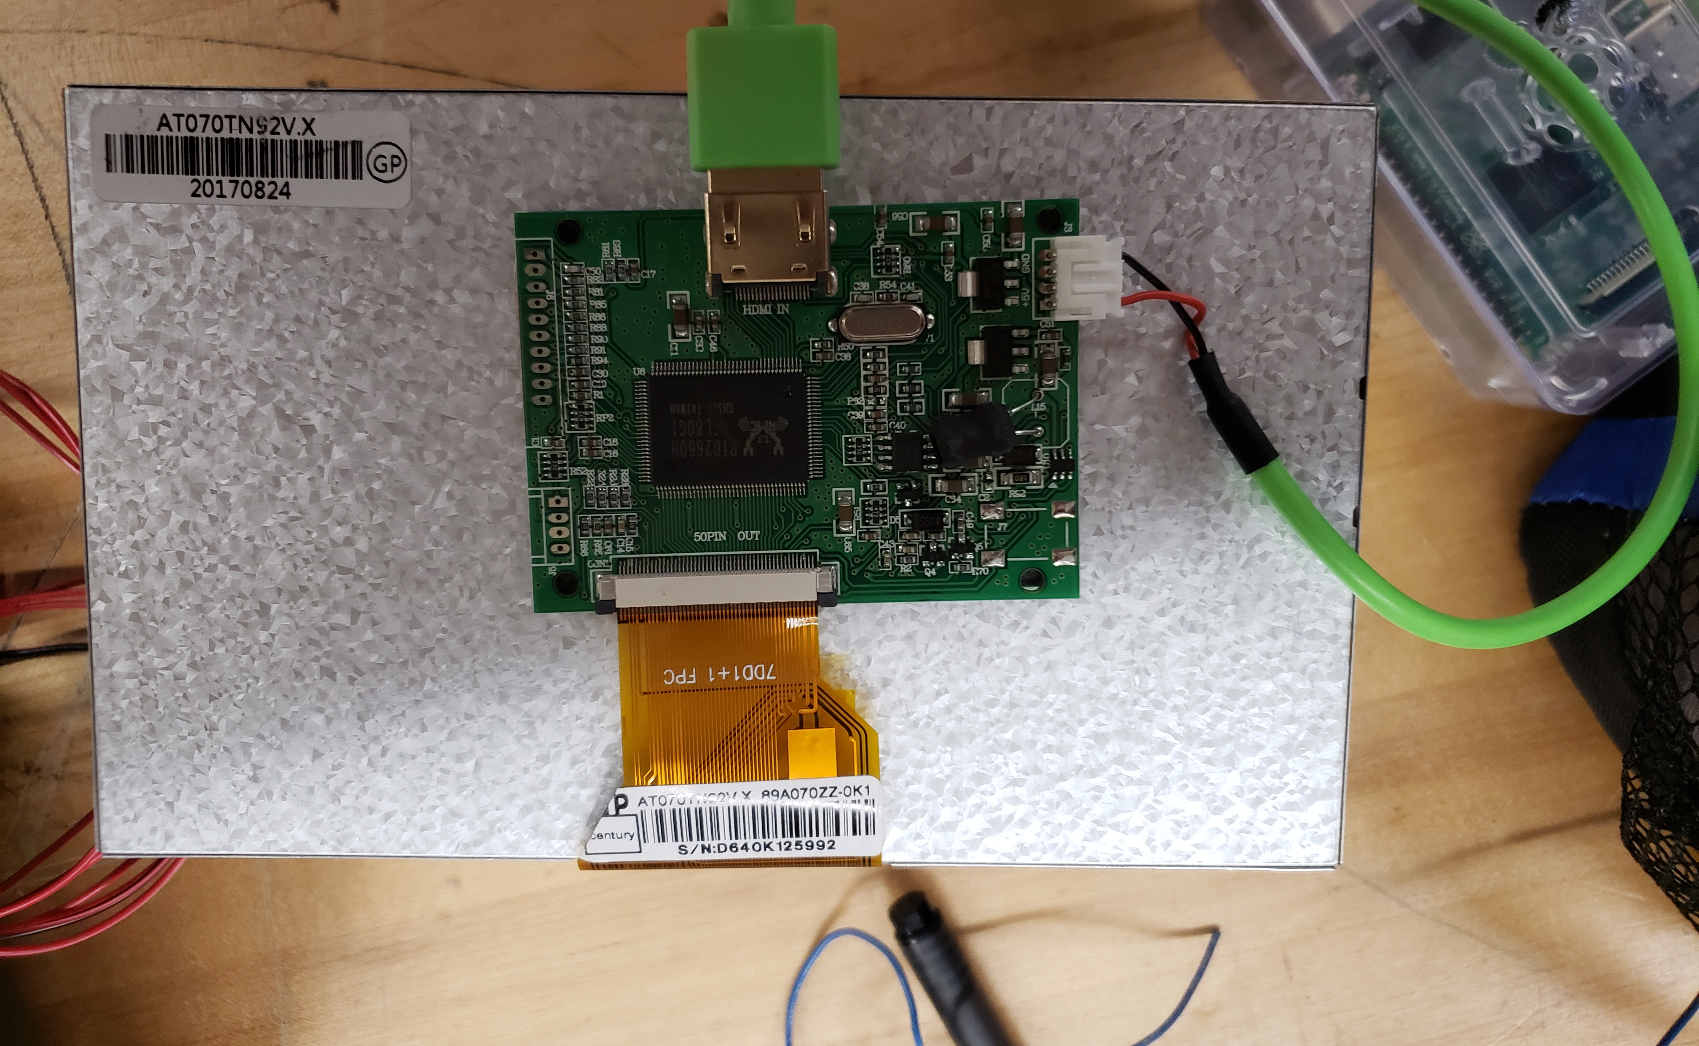
Piper LCD Display
9 inch display
Runs on 5v, 500mA
HDMI input
Compatible with Raspbarry pi video drivers
Screen | Resolution | Screen size | price | Weight | shop
Axion ACN-5507 | Unknown | 5 inches | $70.00 | 1.42 pounds | Amazon
BW TFT LCD | 320 x 240 | 3.1 inches | $20.00 | .4 pounds | Amazon
Phone | 720×1280 | 4.7 in to 6.5 in | N . A . | .3 pounds | N . A .
Piper LCD Display | Unknown | 9 inches | N . A . | .4 pounds | N . A .
Notes:
Jimmy Comparison of LCD Displays in a Table

Slide 33
Progress of the Goggles
Successes
Difficulties
Attached the IR Transmitters
Attached the IR Receivers
Attached the screen
Had to take off the front to fit the screen on
Notes:
Jimmy

Slide 34
Application

Slide 35
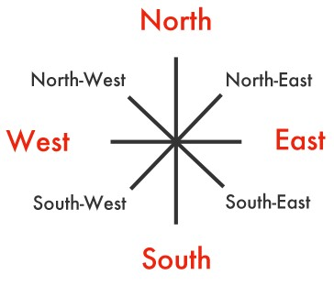
Application
We will be using a Technical Demonstration to test the accuracy of our algorithm.
We will be testing the Cardinal Directions (North, South, East, and West)

Slide 36
Selecting a Communication Protocol SPI vs I2C vs UART
SPI Pros | I2C Pros | UART Pros
Fastest Communication Protocol | Only Uses Two Wires | Simple to Operate
Data can transmitted and received at the same time | Supports Multiple Masters and Slaves | Previous Experience
Supports Multiple Slaves |  | No Clock Needed
 |  | Parity Bit
SPI Cons | I2C Cons | UART Cons
No Way to check for Errors | Complexity Increases as number of devices increases | Cannot Use Multiple Master and Slaves
Notes:
Patrick

Slide 37
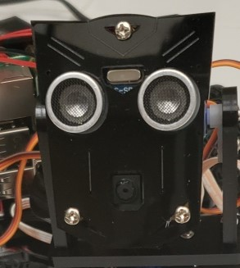
Stretch Goal
Our Stretch Goal for the Project is an application utilizing a camera mounted onto a servo motor.
The LCD display on the goggles will show what the camera is viewing in realtime.
The servo motor will be controlled by an algorithm run on the Raspberry Pi. The Algorithm will decipher the data and depending on the gaze of the user of the goggles the servo motor will respond accordingly.

Slide 38
Progress of the Application
Successes
Difficulties
Application successfully built using tkinter in Python.
Could not make enough progress to implement stretch goal.
Notes:
Patrick

Slide 39
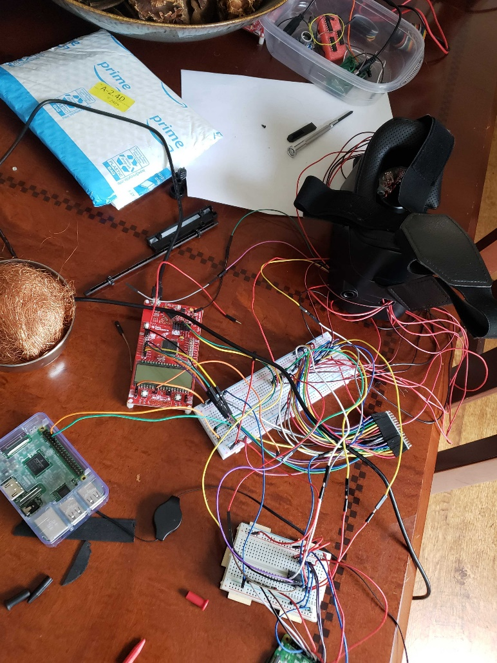
Prototype Final

Slide 40
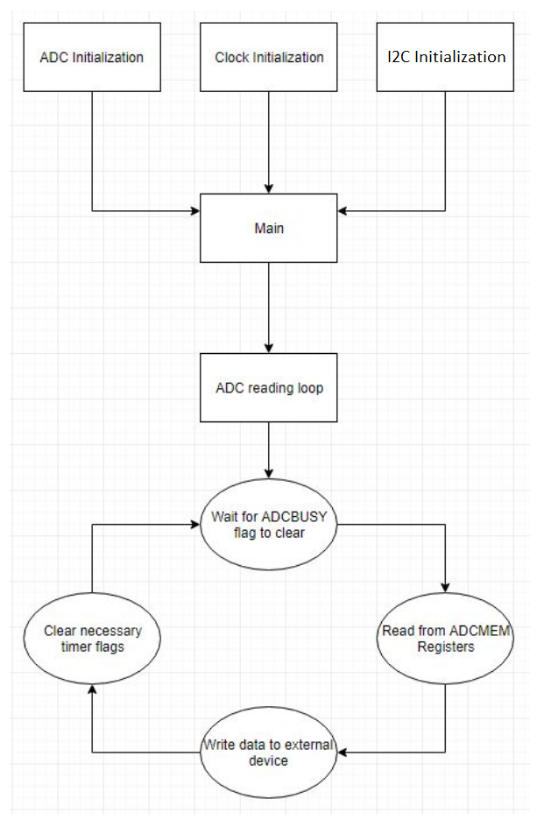
State Algorithm
Programming block representation of functional msp430 code
Notes:
Mike

Slide 41
Machine Learning
Model will take the 16 sensor values to predict the eyes current position
The model will be trained using sampled data with the known eye positions
Preliminary testing will be done in in Python using the Keras API, which is specifically designed to create easy-to-use deep learning models
Notes:
Mike

Slide 42
Budget
Item | Supplier | Cost | # Units | Total Cost
Raspberry Pi | Amazon | $64.99 | 1 | Omitted
MSP 430 | digikey | $10.44 | 1 | Omitted
Selector Chip | digikey | $0.98 | 10 | $9.80
Goggles | Walmart | $49.50 | 1 | Omitted
Miscellaneous | Walmart | $8.00 | 1 | $8.00
IR Transmitters | Radioshack | $2 | 5 | $10.00
IR Receivers | Radioshack | $1.50 | 14 | $21.00
PCB | Quality Manufacturing Services inc. | $121 | 5 | $498.00
Total |  |  |  | $646.8
Notes:
Jimmy

Slide 43
Work Distribution
Primary - P Secondary – S | Timothy | James | Patrick | Mike
System | P | S
Power | S | P
Application |  |  | P | S
Processing Unit |  |  | S | P
PCB | S |  |  | P
Administrative |  | P | S

